Slide 1
Custom components pt 4 – shadow DOM
Encapsulated, single-responsibility, reusable code

Slide 2

Contents
What is the shadow DOM?
Why do we need it?
How to use it?

Slide 3
What is the Shadow DOM?
An important aspect of web components is encapsulation — being able to keep the markup structure, style, and behavior hidden and separate from other code on the page.
The Shadow DOM API is a key part of this, providing a way to attach a hidden separated DOM to an element.

Slide 4
What is the Shadow DOM?
The shadow DOM was NOT designed for custom components, it existed for internal use.
Examine the ‘elements’ tab in your developers tools for an element <input type=“range”> and you’ll see a shadow-root
It ensures that the internal elements can’t be accidentally affected by global scripts or CSS

Slide 5
Shadow DOM
You can add a shadow DOM tree to any element…
Document
Element
Element
Element
Shadow host
…which then becomes a “shadow host”
Shadow root
Element
Element
JavaScript & CSS cannot affect across this barrier

Slide 6
ShadowCounter example
Create a new shadow root
constructor() {
// Always call the super
super();
this._shadowRoot = this.attachShadow({mode: 'open'});
this._shadowRoot.innerHTML = `
<style>
h1 {color: red;}
span {font-size: 40px; background-color: black;
color: white; padding: 4px; border-radius: 4px;
}
</style>
<h1>ShadowCounter</h1>
<div><span id="counter"></span?</div>
`;
}
Create the html template for the component
Some CSS
Some HTML

Slide 7
ShadowCounter example
Find the counter in the shadow DOM
connectedCallback() {
this.value = this.DEFAULT_VALUE;
// Install the event listener
this._counterView = this._shadowRoot.querySelector('#counter’);
this._counterView.addEventListener('mousedown', this._updateCounter.bind(this));
// Call the render function
this.render();
}
Attach the event listener

Slide 8
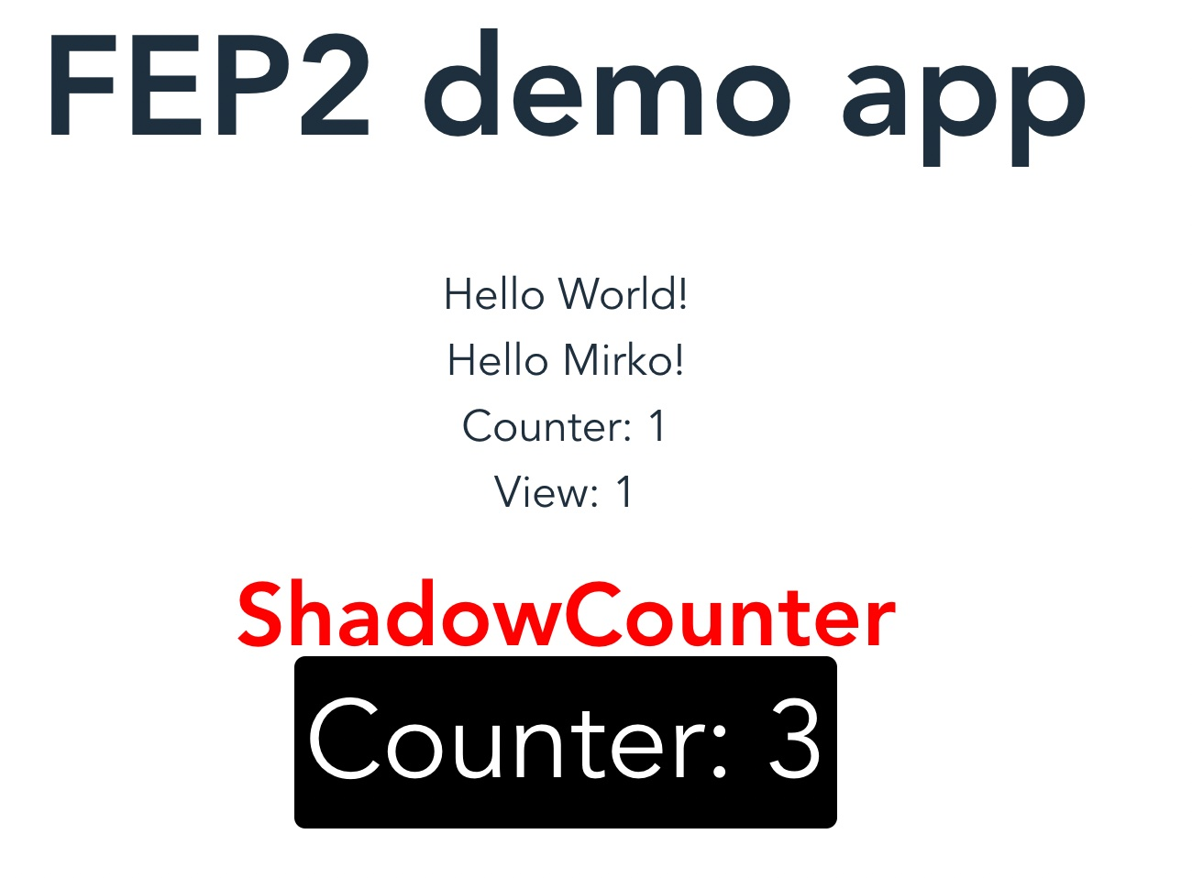
ShadowCounter example
<h1> outside the shadow DOM
<span> outside the shadow DOM
id=“counter” outside the shadow DOM
<h1> inside the shadow DOM
id=“counter” inside the shadow DOM
<span> inside the shadow DOM

Slide 9
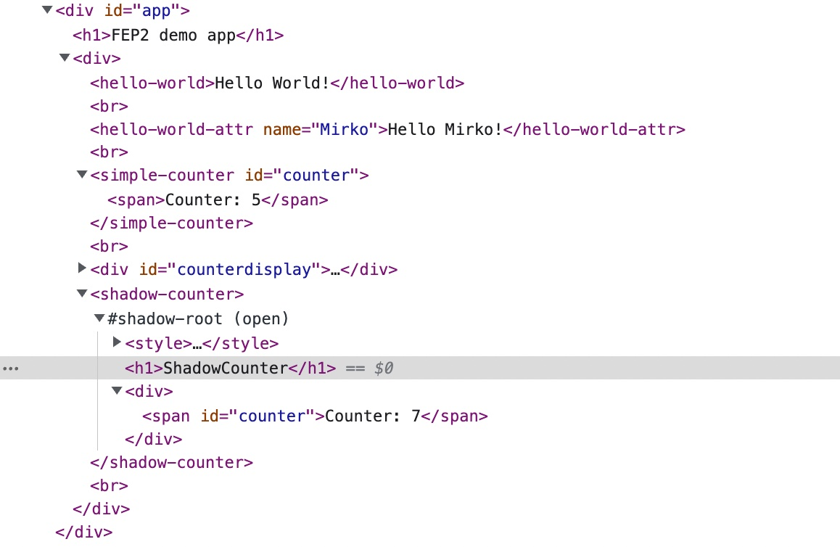
ShadowCounter example
<h1> outside the shadow DOM
id=“counter” outside the shadow DOM
<span> outside the shadow DOM
Shadow root
<h1> inside the shadow DOM
id=“counter” inside the shadow DOM
<span> inside the shadow DOM

Slide 10
Conclusion
The shadow DOM encasulates the web component
Seperates components HTML and CSS from the rest of the application

